Slide 1


Slide 2
Topic Guass’s Law and It’s Applications

Slide 3
Gauss’s Law
Statement.
History of Gauss’s law.
Understanding of Gauss's law.
Proof of Gauss’s law.
Applications of Gauss’s law.

Slide 4




GAUSS’S LAW
Statement : “The total flux of electric field through a closed surface is equal to
times the total charge enclosed by it”.
Mathematical expression
= 8.854 x F/m (farads per meter).
Q=charge in surface

Slide 5
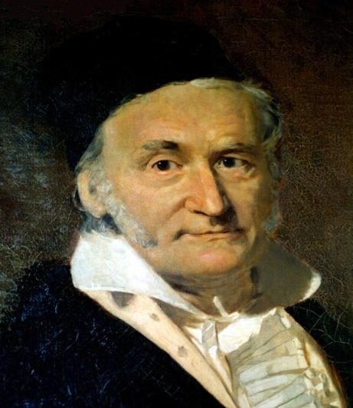
HISTORY OF GAUSS ‘S LAW.
Gauss law was formulated by German scientist Carl Friedrich Gauss(1777-1855) in 1835 but was not publish until 1867.
Carl fried rich got noble prize for application of mathematics and physics.
Gauss law is also known as Gauss flux.
CARL FRIEDRICH GAUSS

Slide 6
Understanding Of Gauss’s Law.
Gauss law relates the distribution of electric charge to the resulting electric field.
Gauss law allows us to find electric field without needing to integrate.
Gauss's law is one of the four Maxwell equations.

Slide 7
Understanding of Gauss's law
Gauss’s law is just a flux calculation.
Gauss’s law is only applied to closed surfaces called Gaussian surface.
Gauss’s law directly relates electric flux to the charge distribution that creates it.
Gauss’s law can be used to derive the coulomb’s law, and vice versa.

Slide 8

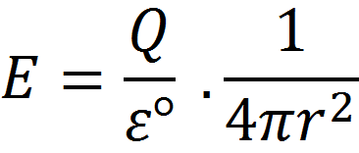
PROOF OF GAUSS’S LAW
Gauss's law can be proved by using Coulomb’s law.
Equation of Coulomb’s law;
We can write it as;

Slide 9

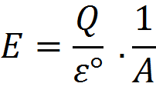
PROOF OF GUASS’S LAW
Now;
(Area of Gaussian surface)
So;

Slide 10
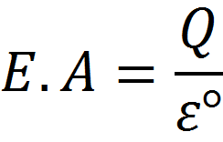
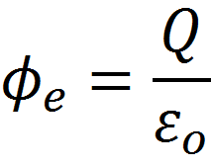
PROOF OF GUASS’S LAW
Hence we can write;
Finally;
Hence Gauss's Law is proved.

Slide 11
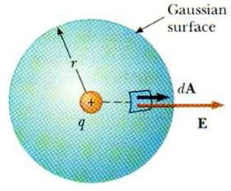
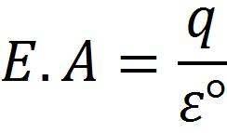
APPLICATION OF GAUSS’S LAW
DERIVATION OF COULOMB’S LAW BY
GAUSS’S LAW
Equation of Gauss’s law ;
So we can write;

Slide 12
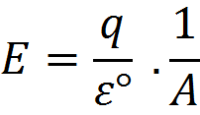
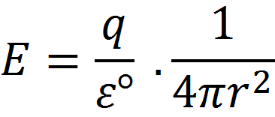
DERIVATION OF COULOMB LAW BY GAUSS’S LAW
Surface area of the sphere is ;
Now;
So;

Slide 13
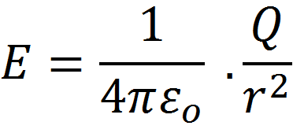
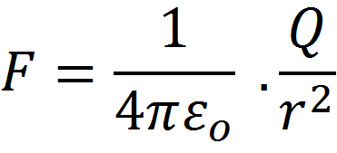
DERIVATION OF COULOMB LAW BY GAUSS’S LAW
We can write the equation as;
Here E is the electric pressure which is also known as Force.
So the equation becomes,
Hence coulomb’s law is derived.

Slide 14
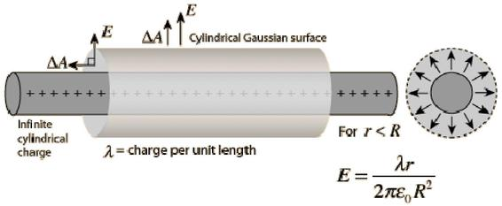
Electric field due to line charge
Consider a long thin uniformly charged wire and we have to find the electric field intensity due to the wire at any point at perpendicular distance from the wire.
If the wire is very long and we are at point far away from both its ends then field lines outside the wire are radial and would lie on a plane perpendicular to the wire.
Electric field intensity have same magnitude at all points which are at same distance from the line charge.
We can assume Gaussian surface to be a right circular cylinder of radius r and length l with its ends perpendicular to the wire as shown below in the figure.

Slide 15

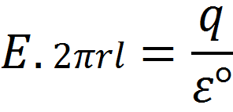
Electric field due to line charge
Thus electric field intensity of a long positively charged wire does not depends on length of the wire but on the radial distance r of points from the wire.
Surface area of the cylinder is;

Slide 16

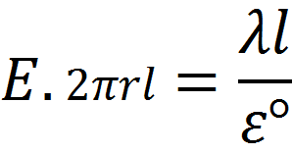
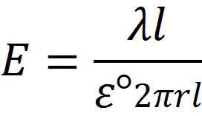
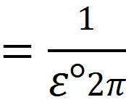
Electric field due to line charge
Charge enclosed in a cylinder =linear charge*length of the cylinder
Putting the value of q,
Here , constant

Slide 17
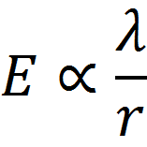
Electric field due to line charge
Hence proved that
Thus electric field intensity of a long positively charged wire does not depend upon the length of the wire, But, on the radial distance “r” of point from the point.

Slide 18
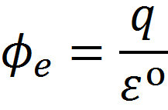
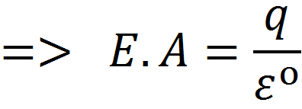

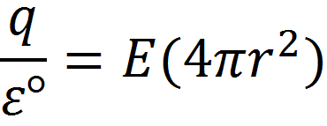

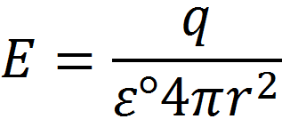
Electric filed line due to solid sphere
In this case Gaussian surface would be a sphere of
radius r>R concentric with charge
Charge distributed over the surface
By putting the value of E.A

Slide 19
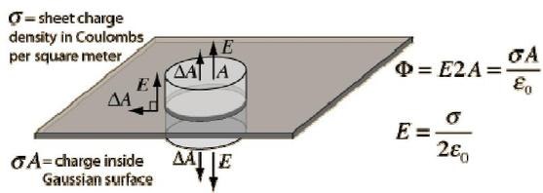
Electric field due to infinite sheet of charge
Consider a thin infinite plane sheet of charge having
surface charge density σ(charge per unit area).
We have to find the electric field intensity due to this sheet at ant point which is distance r away from the sheet.
We can draw a rectangular Gaussian pillbox extending equal distance above and below the plane as shown below in the figure.

Slide 20
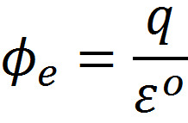
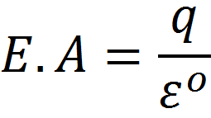
Electric field due to infinite sheet of charge
The electric field due to infinite sheet of charge is calculated bellow

Slide 21

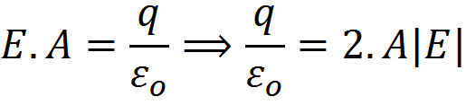
Neglecting the directions of A and E. The Area A becomes double and E becomes |E|. So equation becomes… Now according to Gauss's law;

Slide 22

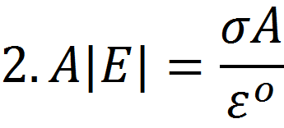
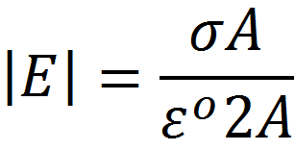
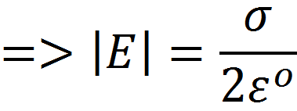
Electric field due to infinite sheet of charge
Here ;
So we can write;
Hence we have the final result

Slide 23
Reference
Taken From Internet from multiple links e.g.:-
Wikipedia,Physicscatalyst,etc…

Slide 24


